Slide 1
Constructors

Slide 2
Constructor in java
Constructor in java is a special type of method that is used to initialize the object.
Java constructor is invoked at the time of object creation. It constructs the values i.e. provides data for the object that is why it is known as constructor.
Rules for creating java constructor
There are basically two rules defined for the constructor.
Constructor name must be same as its class name
Constructor must have no explicit return type

Slide 3
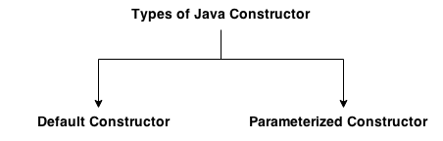
Types of constructors
There are two types of constructors:
Default constructor (no-arg constructor)
Parameterized constructor

Slide 4
default constructor
A constructor that have no parameter is known as default constructor.
Syntax of default constructor:
<class_name>(){}
Example
class Bike1{
Bike1()
{System.out.println("Bike is created");}
public static void main(String args[]){
Bike1 b=new Bike1();
} output :
Bike is created
}

Slide 5
If there is no constructor in a class, compiler automatically creates a default constructor.
Default constructor provides the default values to the object like 0, null etc. depending on the type.

Slide 6
Example of default constructor that displays the default values
class Student3{
int id;
String name;
void display(){System.out.println(id+" "+name);}
public static void main(String args[]){
Student3 s1=new Student3();
Student3 s2=new Student3();
s1.display();
s2.display();
} 0 null
0 null
}

Slide 7
parameterized constructor
A constructor that have parameters is known as parameterized constructor.
Parameterized constructor is used to provide different values to the distinct objects.

Slide 8
Example of parameterized constructor
class Student4{
int id;
String name;
Student4(int i,String n){
id = i;
name = n;
}
void display()
{System.out.println(id+" "+name);}
public static void main(String args[]){
Student4 s1 = new Student4(111,"Karan");
Student4 s2 = new Student4(222,"Aryan");
s1.display();
s2.display();
}
}
111 Karan
222 Aryan

Slide 9
Constructor Overloading in Java
Constructor overloading is a technique in Java in which a class can have any number of constructors that differ in parameter lists.
The compiler differentiates these constructors by taking into account the number of parameters in the list and their type.

Slide 10
Example of Constructor Overloading
class Student5{
int id;
String name;
int age;
Student5(int i,String n){
id = i;
name = n;
}
Student5(int i,String n,int a){
id = i;
name = n;
age=a;
}
void display(){System.out.println(id+" "+name+" "+age);}
public static void main(String args[]){
Student5 s1 = new Student5(111,"Karan");
Student5 s2 = new Student5(222,"Aryan",25);
s1.display();
s2.display();
}
}
111 Karan 0
222 Aryan 25

Slide 11
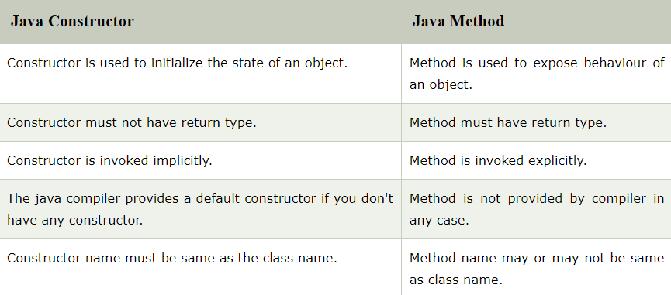
Difference between constructor and method in java

Slide 12
Copy Constructor
There is no copy constructor in java. But, we can copy the values of one object to another like copy constructor in C++.
There are many ways to copy the values of one object into another in java.
They are:
By constructor
By assigning the values of one object into another
By clone() method of Object class

Slide 13
Example
class Student6{
int id;
String name;
Student6(int i,String n){
id = i;
name = n;
}
Student6(Student6 s){
id = s.id;
name =s.name;
}
void display(){System.out.println(id+" "+name);}
public static void main(String args[]){
Student6 s1 = new Student6(111,"Karan");
Student6 s2 = new Student6(s1);
s1.display();
s2.display();
}
}
111 Karan
111 Karan

Slide 14
static keyword
The static keyword in java is used for memory management mainly.
We can apply java static keyword with variables, methods, blocks and nested class.
The static keyword belongs to the class than instance of the class.

Slide 15
The static can be:
variable (also known as class variable)
method (also known as class method)
block
nested class

Slide 16
Static variable
class Student8{
int rollno;
String name;
static String college =“RVR";
Student8(int r,String n){
rollno = r;
name = n;
}
void display (){System.out.println(rollno+" "+name+" "+college);}
public static void main(String args[]){
Student8 s1 = new Student8(111,"Karan");
Student8 s2 = new Student8(222,"Aryan");
s1.display();
s2.display();
}
}

Slide 17
Example
class Counter{
int count=0;//will get memory when instance is created
Counter(){
count++;
System.out.println(count);
}
public static void main(String args[]){
Counter c1=new Counter();
Counter c2=new Counter();
Counter c3=new Counter();
}
}
1
1
1

Slide 18
Static variable Example
class Counter2{
static int count=0;//will get memory only once and retain its value
Counter2(){
count++;
System.out.println(count);
}
public static void main(String args[]){
Counter2 c1=new Counter2();
Counter2 c2=new Counter2();
Counter2 c3=new Counter2();
}
}
1
2
3

Slide 19
Java static method
If you apply static keyword with any method, it is known as static method.
A static method belongs to the class rather than the object of a class.
A static method can be invoked without the need for creating an instance of a class.
A static method can access static data member and can change the value of it.

Slide 20
Static variable & static method example
class Student9{
int rollno;
String name;
static String college = “RVR";
static void change(){
college = “RVRJC";
}
Student9(int r, String n){
rollno = r;
name = n;
}
void display (){System.out.println(rollno+" "+name+" "+college);}
public static void main(String args[]){
Student9.change();
Student9 s1 = new Student9 (111,"Karan");
Student9 s2 = new Student9 (222,"Aryan");
Student9 s3 = new Student9 (333,"Sonoo");
s1.display();
s2.display();
s3.display();
}
}
111 Karan RVRJC
222 Aryan RVRJC
333 Sonoo RVRJC

Slide 21
The Math class in Java has almost all of its members static. So, we can access its members without creating instances of the Math class. For example,
public class Main {
public static void main( String[] args ) {
// accessing the methods of the Math class
System.out.println("Absolute value of -12 = " + Math.abs(-12));
System.out.println("Value of PI = " + Math.PI);
System.out.println("Value of E = " + Math.E);
System.out.println("2^2 = " + Math.pow(2,2));
}
}
Absolute value of -12 = 12
Value of PI = 3.141592653589793
Value of E = 2.718281828459045
2^2 = 4.0

Slide 22
Restrictions for the static method
There are two main restrictions for the static method.
The static method can not use non static data member or call non-static method directly.
this and super cannot be used in static context.

Slide 23
Example
class A{
int a=40;//non static
public static void main(String args[]){
System.out.println(a);
}
} Output:Compile Time Error

Slide 24
static and non-static Methods
class StaticTest {
// non-static method
int multiply(int a, int b){
return a * b;
}
// static method
static int add(int a, int b){
return a + b;
}
}
public class Main {
public static void main( String[] args ) {
// create an instance of the StaticTest class
StaticTest st = new StaticTest();
// call the nonstatic method
System.out.println(" 2 * 2 = " + st.multiply(2,2));
// call the static method
System.out.println(" 2 + 3 = " + StaticTest.add(2,3));
}
}
2 * 2 = 4
2 + 3 = 5

Slide 25
Why is the Java main method static?
It is because the object is not required to call a static method.
If it is a non-static method, JVM creates an object first then call main() method that will lead the problem of extra memory allocation.

Slide 26
Java static block
Is used to initialize the static data member.
It is executed before the main method at the time of class loading.

Slide 27
Static block
class A2{
static
{
System.out.println("static block is invoked");
}
public static void main(String args[]){
System.out.println("Hello main");
}
}
static block is invoked
Hello main

Slide 28
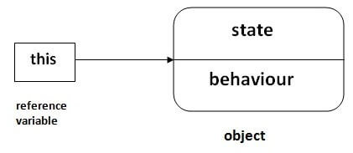
this keyword in Java
In Java, this is a reference variable that refers to the current object.

Slide 29
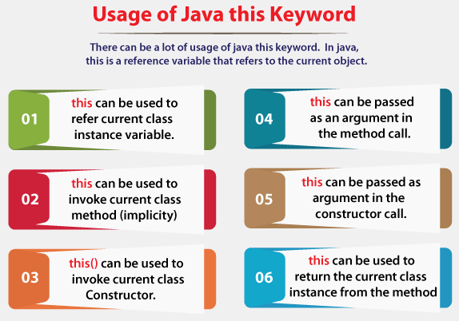

Slide 30
1) this: to refer current class instance variable
The this keyword can be used to refer current class instance variable.
If there is ambiguity between the instance variables and parameters, this keyword resolves the problem of ambiguity.

Slide 31
without using this keyword
0 null 0.0 0 null 0.0
class Student{
int rollno;
String name;
float fee;
Student(int rollno,String name,float fee){
rollno=rollno;
name=name;
fee=fee;
}
void display(){System.out.println(rollno+" "+name+" "+fee);}
}
class TestThis1{
public static void main(String args[]){
Student s1=new Student(111,"ankit",5000f);
Student s2=new Student(112,"sumit",6000f);
s1.display();
s2.display();
}}
0 null 0.0
0 null 0.0

Slide 32
Above program using this keyword
class Student{
int rollno;
String name;
float fee;
Student(int rollno,String name,float fee){
this.rollno=rollno;
this.name=name;
this.fee=fee;
}
void display()
{
System.out.println(rollno+" "+name+" "+fee);}
}
class TestThis2{
public static void main(String args[]){
Student s1=new Student(111,"ankit",5000f);
Student s2=new Student(112,"sumit",6000f);
s1.display();
s2.display();
}
}
111 ankit 5000.0
112 sumit 6000.0

Slide 33
Note
If local variables(formal arguments) and instance variables are different, there is no need to use this keyword.

Slide 34
this: to invoke current class method
class A{
void m()
{
System.out.println("hello m");
}
void n(){
System.out.println("hello n");
//m();//same as this.m()
this.m();
}
}
class TestThis4{
public static void main(String args[]){
A a=new A();
a.n();
}
}
hello n
hello m

Slide 35
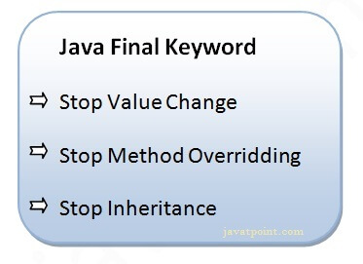
final Keyword In Java
The final keyword in java is used to restrict the user. The java final keyword can be used in many context.
Final can be:
variable
method
class

Slide 36
1) Java final variable
If you make any variable as final, you cannot change the value of final variable(It will be constant).

Slide 37
Example of final variable
class Bike{
final int speedlimit=90;//final variable
void run(){
speedlimit=400;
}
public static void main(String args[]){
Bike obj=new Bike();
obj.run();
}
}
Output: Compile Time Error

Slide 38
2) Java final method If you make any method as final, you cannot override it.
lass Bike{
final void run(){System.out.println("running");}
}
class Honda extends Bike{
void run(){System.out.println("running safely with 100kmph");}
public static void main(String args[]){
Honda honda= new Honda();
honda.run();
}
}
Output: Compile Time Error

Slide 39
Is final method inherited?
Yes, final method is inherited but you cannot override it. For Example:
class Bike{
final void run()
{System.out.println("running...");
}
}
class Honda2 extends Bike{
public static void main(String args[]){
new Honda2().run();
}
}

Slide 40
blank or uninitialized final variable
A final variable that is not initialized at the time of declaration is known as blank final variable.
If you want to create a variable that is initialized at the time of creating object and once initialized may not be changed, it is useful. For example PAN CARD number of an employee.
It can be initialized only in constructor.

Slide 41
Example of blank final variable
class Student{
int id;
String name;
final String PAN_CARD_NUMBER;
...
}

Slide 42
Can we initialize blank final variable? Yes, but only in constructor.
class Bike{
final int speedlimit;//blank final variable
Bike(){
speedlimit=70;
System.out.println(speedlimit);
}
public static void main(String args[]){
new Bike();
}
}
Output: 70

Slide 43
static blank final variable
A static final variable that is not initialized at the time of declaration is known as static blank final variable.
It can be initialized only in static block.

Slide 44
Example of static blank final variable
class A{
static final int data;//static blank final variable
static{ data=50;}
public static void main(String args[])
{
System.out.println(A.data);
}
}

Slide 45
What is final parameter? If you declare any parameter as final, you cannot change the value of it.
class Bike11{
int cube(final int n){
n=n+2;//can't be changed as n is final
n*n*n;
}
public static void main(String args[]){
Bike11 b=new Bike11();
b.cube(5);
}
}
Output: Compile Time Error

Slide 46
Can we declare a constructor final?
No, because constructor is never inherited.

